Slide 1

Code Refactoring and Bug Fixing
By Palak Yadav

Slide 2
Scenario:
A team of enthusiastic data scientists embarked on a mission to develop a Note Taking Application using Python, Flask, and HTML. However, their lack of experience in backend development has led to challenges in making the application fully functional. Recognizing your proficiency in backend development, you have been tasked with fixing the broken code and ensuring the application works seamlessly.
Task:
Refactor the existing codebase and ensure the proper functioning of the Note Taking Application. Document all identified bugs during the debugging process. Remember, the task is not about recreating the app from scratch. Your goal is to fix the already existing codebase and make the application work as intended.

Slide 3
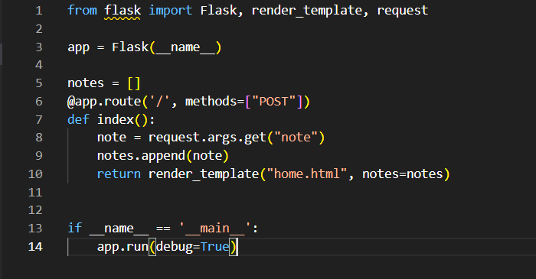
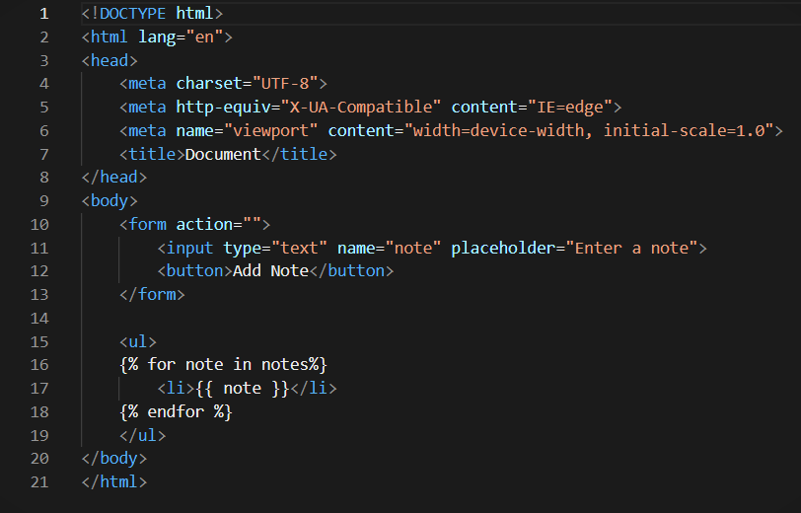
Identifying areas of improvement and Bugs:
The figure 1 and 2 is showing method error, “method not allowed” error is indicating that requested method is not suitable for permitted URL in Flask.
So we need to make some changes in code for successful execution of the above code.

Slide 4
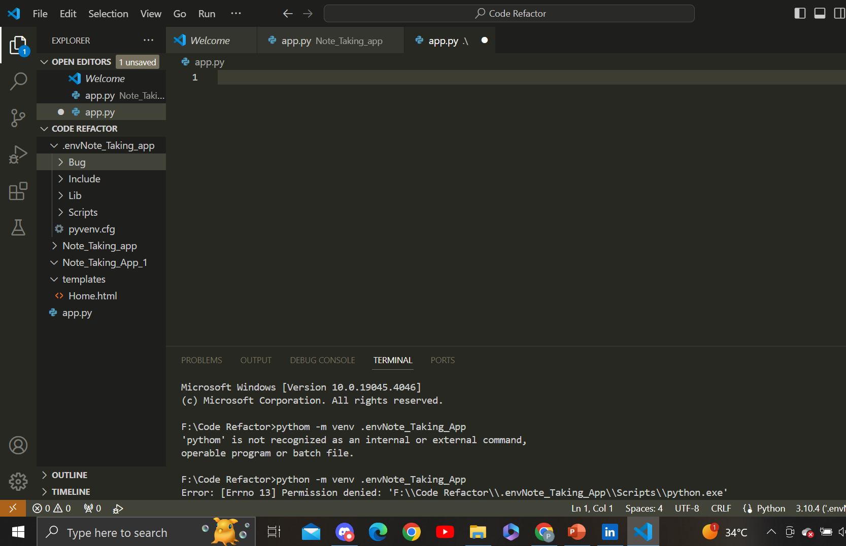
Steps for Code Refactoring and Bug fixing :
Creation of Virtual Enviornment :

Slide 5
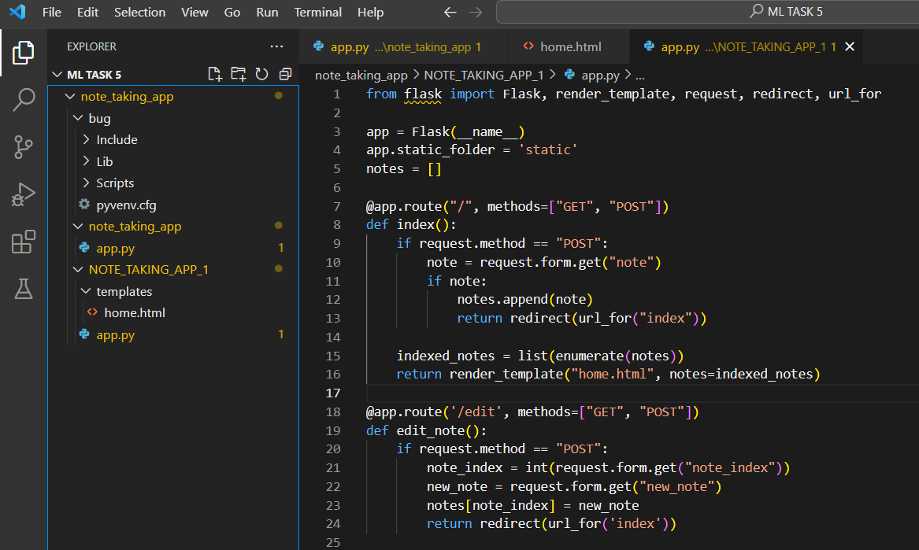
Identifying and correcting Bugs in the python code

Slide 6
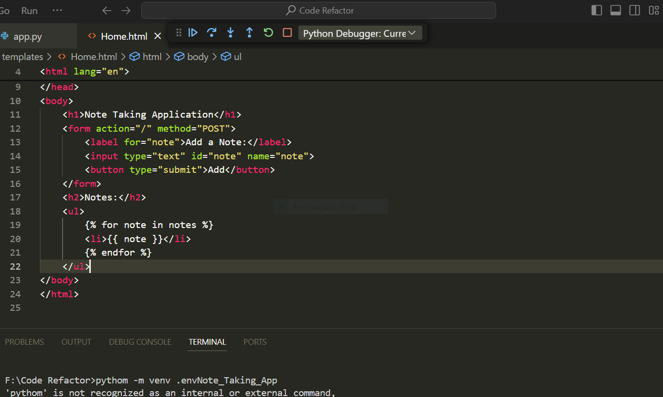

Slide 7
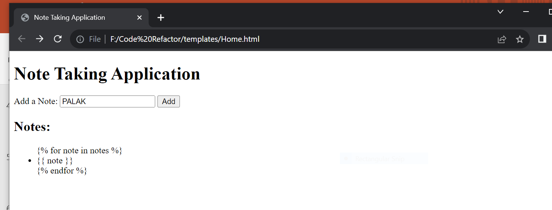
Output :

Slide 8

THANK YOU

